Slide 1
Lancashire Under the Hammer
A Mapping Project
David Adams
HC 421H: Top Digital Humanities
Professor Helen Southworth

Slide 2
Background
In 1928 the Hogarth Press published journalist Ben Bowker’s only book, Lancashire Under the Hammer, as a part of their pamphlet series on domestic issues.
Explained post-war collapse of the cotton industry, and suggested policy for recovery.
Marked a shift for the Hogarth Press because it:
Was written from an “insider’s point of view”
Utilized a new marketing strategy: sold in railway station bookstalls throughout northern England.
Publication info. (Woolmer):
Two impressions
2,000 copies printed – 900 copies pulped = 1,100 that could still be in existence
I was able to find over 100 of those copies.

Slide 3
My Project
Goals:
Visualize the spread of Bowker’s ideas
Establish the identity of early readers and potential connections between them
Methods:
Checked out UO volume
Mapped original railway bookstalls where book was sold using list from Bowker’s folder at the University of Reading’s Hogarth Press Archive.
Mapped current location of copies I found in libraries and bookstores
Inquired for prior ownership information from booksellers
Searched databases for book reviews

Slide 4
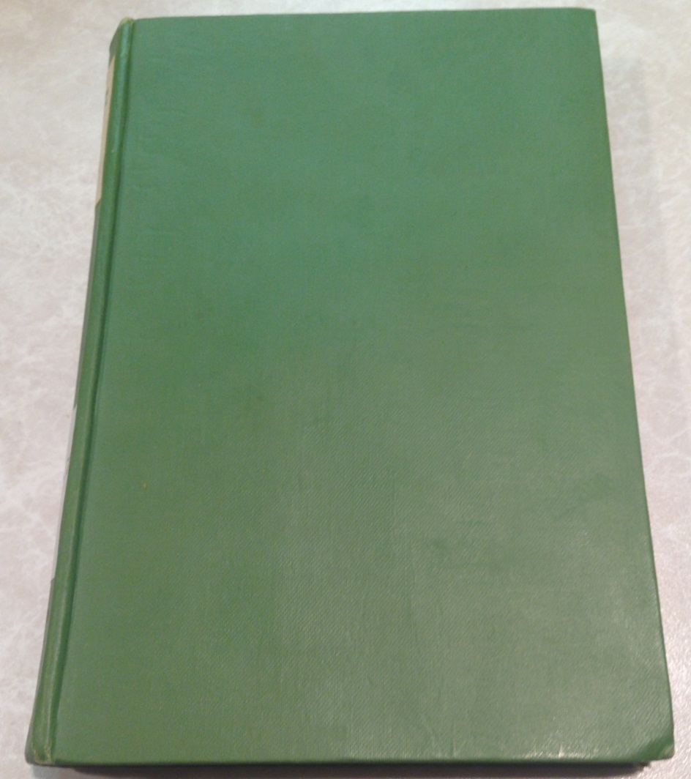
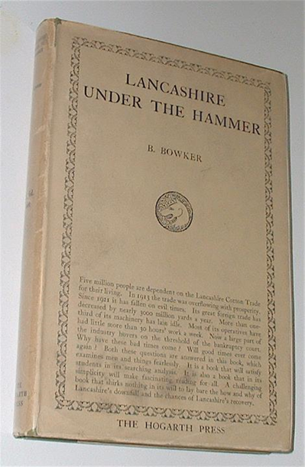
Physical Attributes
“Five million people are dependent on the Lancashire Cotton Trade for their living. In 1913 the trade was overflowing with prosperity. Since 1921 it has fallen on evil times. Its great foreign trade has decreased by nearly 3000 million yards a year. More than one-third of its machinery has lain idle. Most of its operatives have had little more than 30 hours’ work a week. Now a large part of the industry hovers on the threshold of the bankruptcy court. Why have these bad times come? Will good times ever come again? Both these questions are answered in this book, which examines men and things fearlessly. It is a book that will satisfy students in its searching analysis. It is also a book that in its simplicity will make fascinating reading for all. A challenging book that shirks nothing in its will to lay bare the how and why of Lanashire’s downfall and the chances of Lancashire’s recovery.”

Slide 5
MY DATA: LIST OF RAILWAY STATION BOOKSTALLS WHERE BOWKER’S BOOK COULD BE PURCHASED (held at u. of reading, uk)

Slide 6
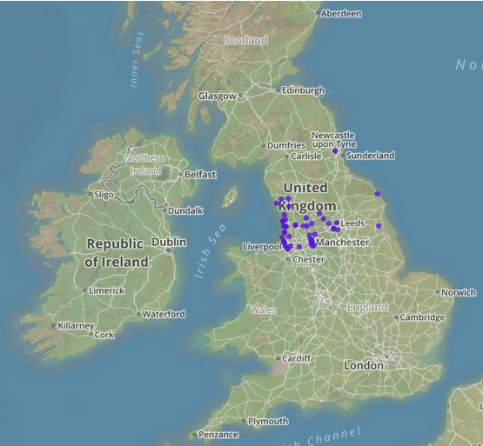
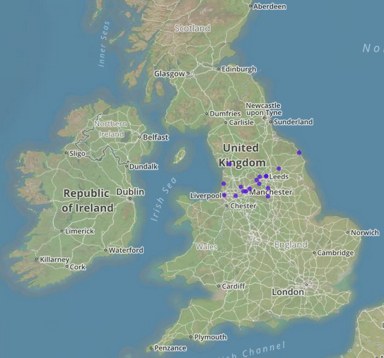
Train station maps

Slide 7
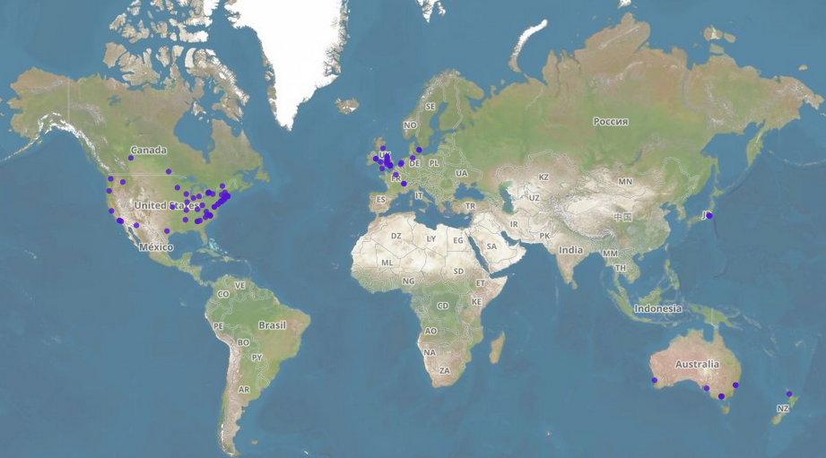
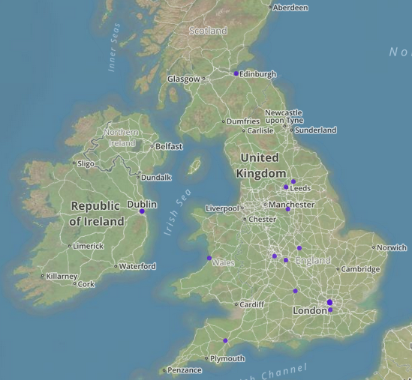
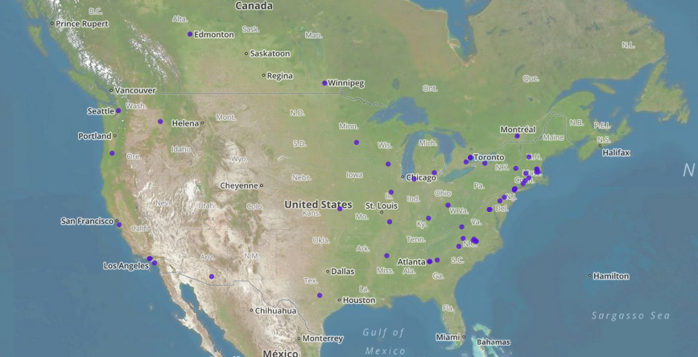
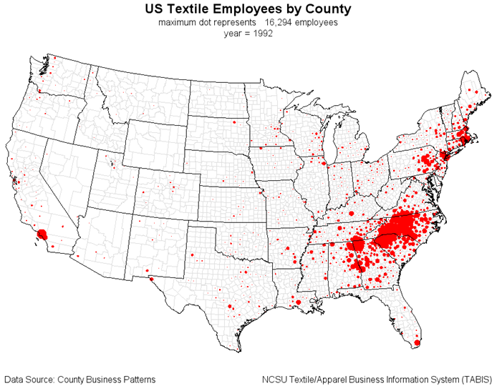
Library holdings (WORLDCAT & COPAC)
Robert Allison, Ph.D. http://robslink.com/tabis/phd_1991_1996/chapter6.htm

Slide 8
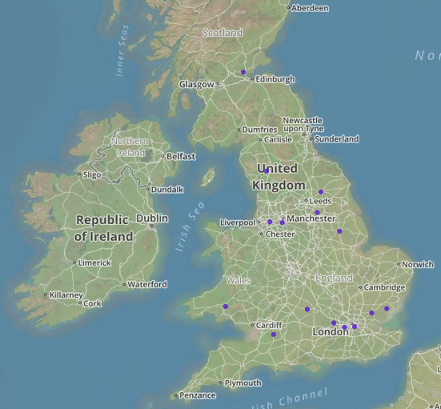
Booksellers (CURRENT ONLINE)

Slide 9
Early Readership
Asked booksellers if:
They could provide any historical information about their copy.
There are any inscriptions giving records of prior ownership or original place of sale.
From replies and initial listings:
Two former library holdings
Barnett Library at Oxford → University of Salford
Dunfermline Public/Central Library
Three former owners

Slide 10
Three former owners
D. Jordan (September 20, 1929)
Mr. Peter Eadie → Stuart F. Brown
No info. on Stuart F. Brown
Peter Eadie
Great-grandfather of Tony Benn (British Politician)
Imaginative, politically active
Engineer who invented Ring Traveler
B. Bowker → Frank Rudd Simpson
Frank R. Simpson
Engineer?
Textile industry?

Slide 11
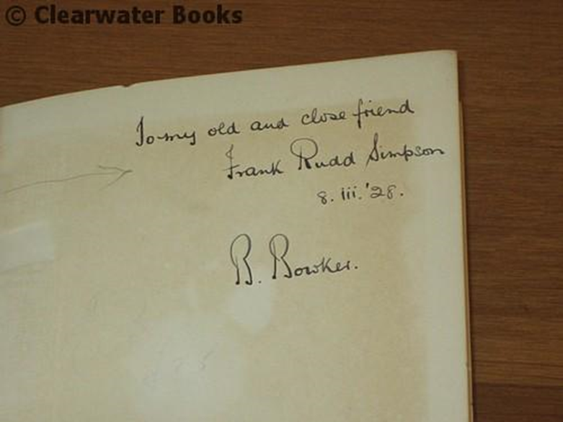
Signed copy
To my old and close friend Frank Rudd Simpson 8.iii.'28. B Bowker

Slide 12
Book Reviews
John Jewkes, The Economic Journal, December 1928
H. L. Beales Economica, April 1929
C.R. fay, Journal for the Royal Statistical Scociety, January 1928

Slide 13
Future Directions
I focused on spread of Bowker’s book from bookstalls at northern England train stations to current location of holdings
I started to look for prior ownership information, but was unable to gather much material
Future work should more thoroughly investigate early readership through crowdsourcing
Could reveal potentially interesting connections between people from that era

